Slide 1

Presentation for MIS project
Prepared By: Abdul wahid “Sharifi”

Slide 2
INTRODUCTION OF KATIB UNIVERSITY
Katib university is one of the private university that is located in dehmazang kabul
After the evaluation of their current network of this university, I have discovered out that their network is consist of basic configuration which lack many essential features and services. Even there is no a centralized server in order to control the whole network of the university .

Slide 3
The network design of KATIB UNIVERISTY was as following:
There was not any central point for controlling the users and data
All computers were connected together without any domain and doman policy
All the users were using flash and Har disk for saving of data
Data broadcast

Slide 4
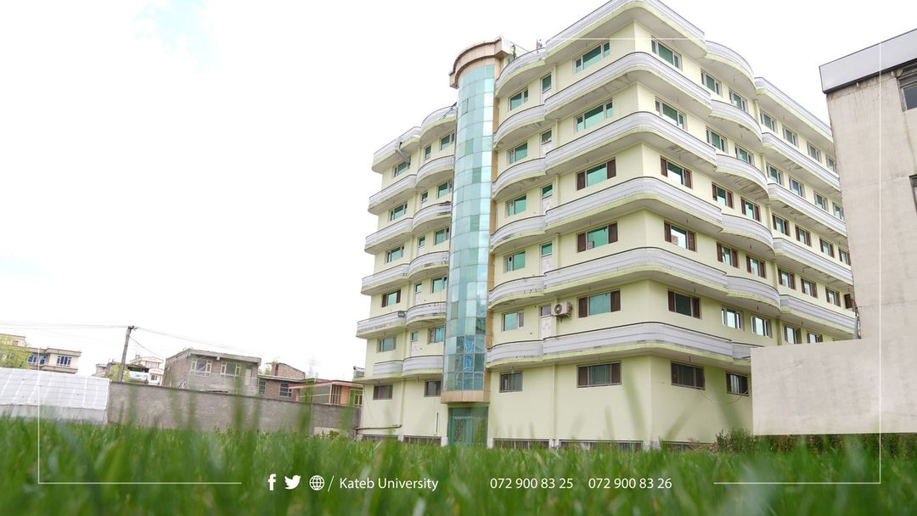

Slide 5
Requirements :
In order to create this topology the following up to date and standard devices are needed and the key components are the following in the list.
Hardware Requirements :
Cisco Routers for WAN connection and communication
Cisco switch for LAN communication for a specific department
UTP and STP cables
RJ45 Connectors
Server

Slide 6
Software Requirement :
Windows Server 2016
Windows 10 pro for users and clients
Vm machines for Server and clients
Packet tracer for testing and implementing

Slide 7
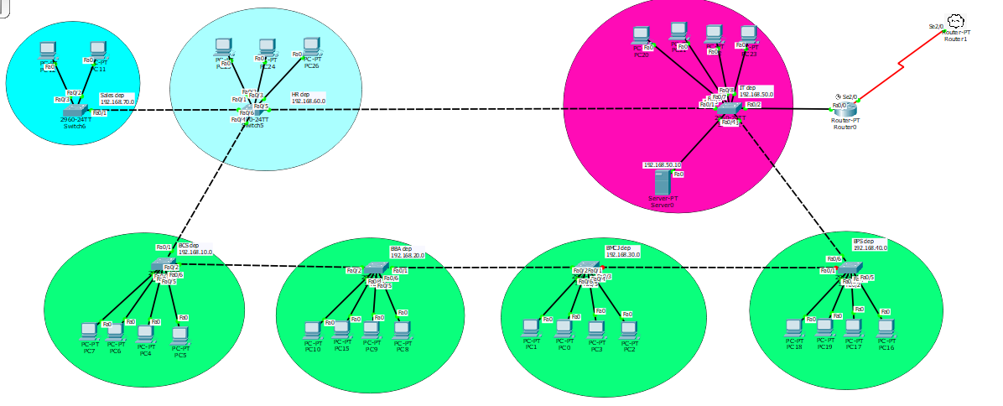

Slide 8
The services which will be provide by the project are:
DNS
Reverse lookup zone
Forward lookup zone
DHCP
Assigning dynamic IP address
Use a specific Range of address

Slide 9
ADDS
To apply policies
Create and manage users
Create Groups and OU’s
Vlan
To separate the branches
Port-security
To disallow unauthenticated users from getting access to network

Slide 10
Thank you!
Do you have any questions?
Email : wahidsharifi8@gmail.com
Phone Number : 0789000000

